Slide 1
How to make NAS more efficient?
Yuncheng Jiang
2020-07-17

Slide 2
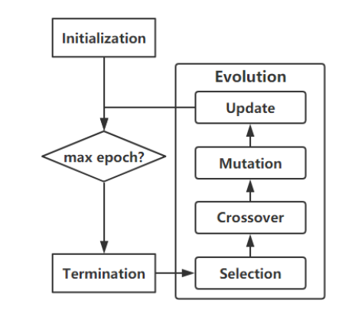
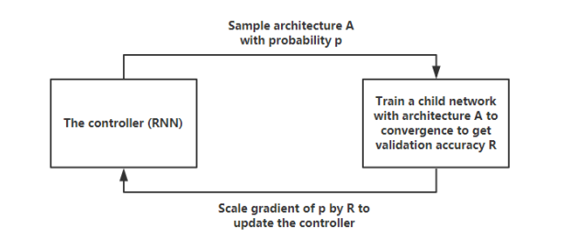
Search-Discrete Search Space
RL
EA

Slide 3
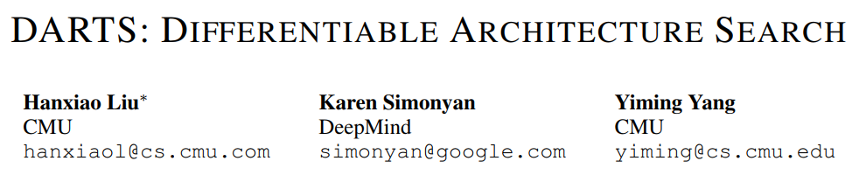
Search-Differentiable Search Space

Slide 4
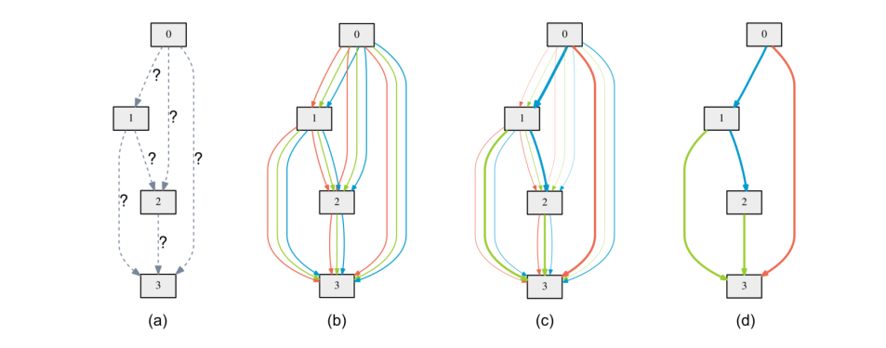
Overview

Slide 5
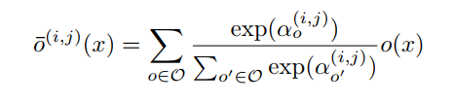
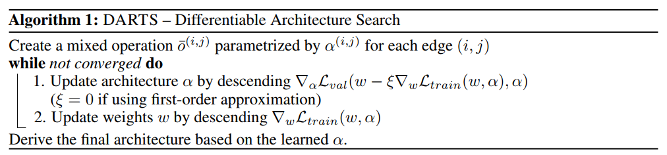
Continuous Relaxation
all possible operations
Updata the architecture and parameter in two different stage

Slide 6
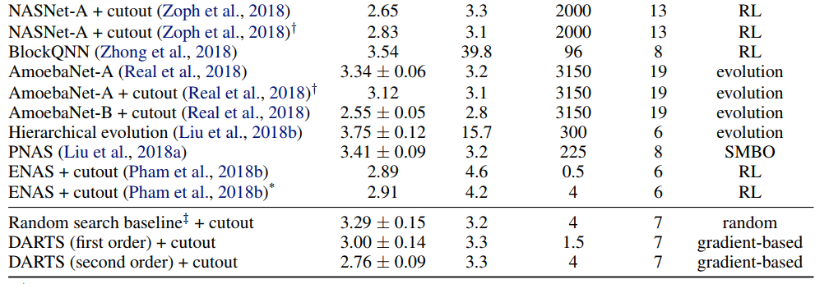
Result

Slide 7
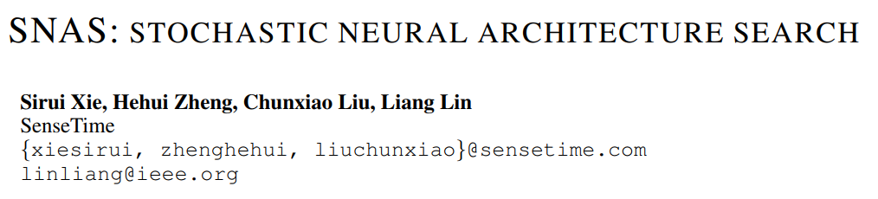
ICLR 2019

Slide 8
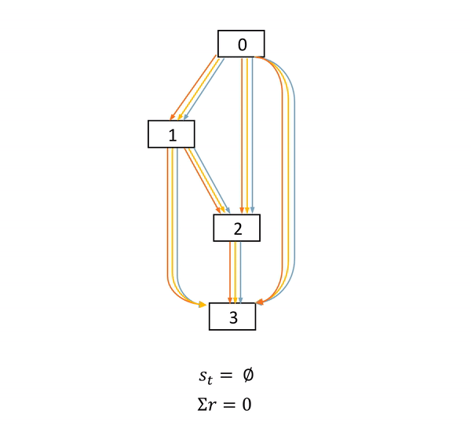
fully delayed reward
Feature map
S: state
r: reward
a: action
operations
In the Monte Carlo method, you have to go through the whole sample to get the reward

Slide 9
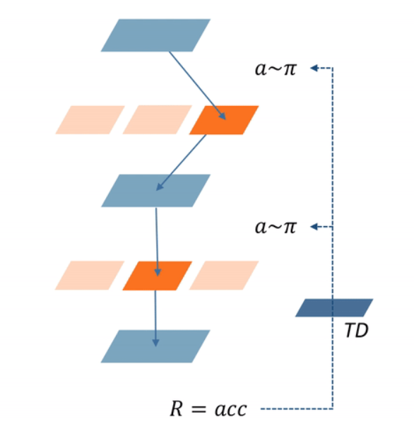
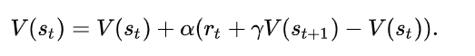
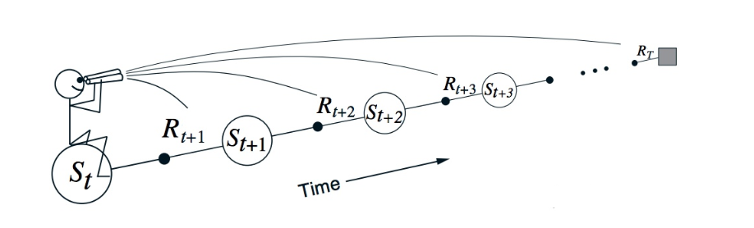
Problem in RL
预期目标奖励
误差
Task complexity
Expect bias
Converge time

Slide 10
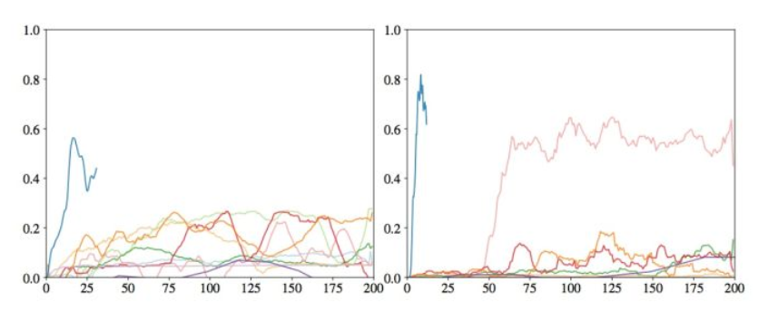
Differentiable vs TD
D
TD
D-based object function faster than TD-based function in fully delay reward
“Rudder: Return decomposition for delayed rewards” arXiv preprint arXiv:1806.07857, 2018.

Slide 11
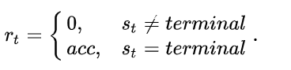
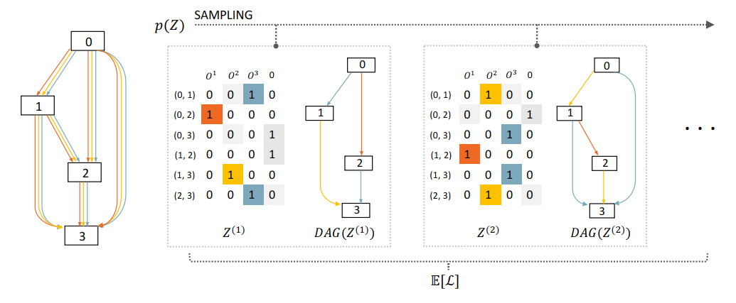
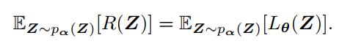
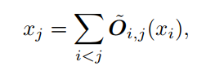
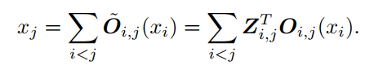
Method :Stochastic Sampling

Slide 12
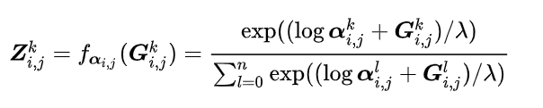
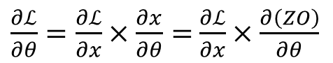
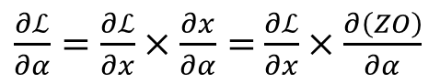
Differentiable approximation
$\frac{∂ℒ}{∂α}=\frac{∂ℒ}{∂x}×\frac{∂x}{∂α}=$ $\frac{∂ℒ}{∂x}×\frac{∂\left(ZO\right)}{∂α}$
$\frac{∂ℒ}{∂θ}=\frac{∂ℒ}{∂x}×\frac{∂x}{∂θ}=$ $\frac{∂ℒ}{∂x}×\frac{∂\left(ZO\right)}{∂θ}$
One-hot random variable
Gumbel random variable
architecture parameter

Slide 13
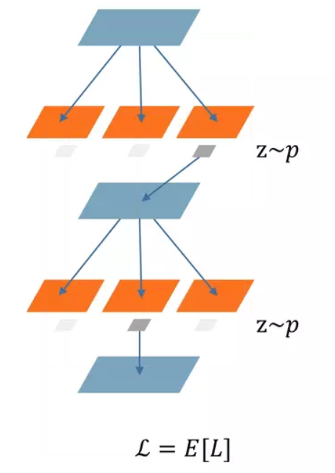
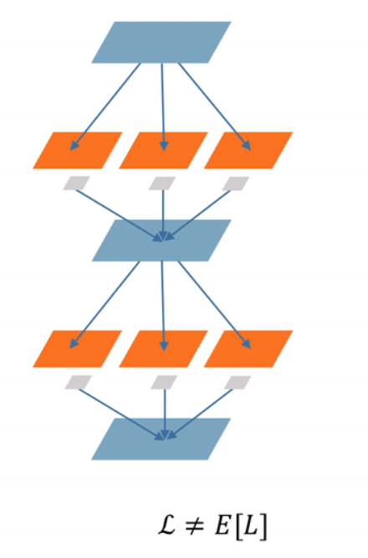
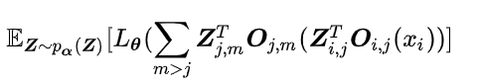
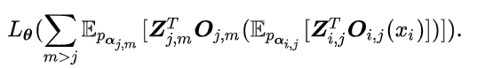
SNAS and DARTS
SNAS
DARTS

Slide 14
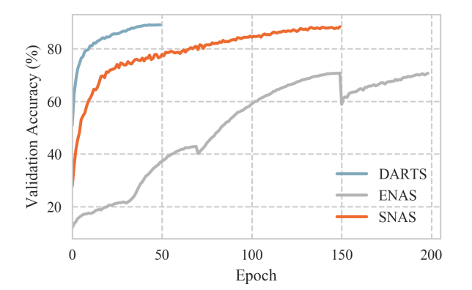
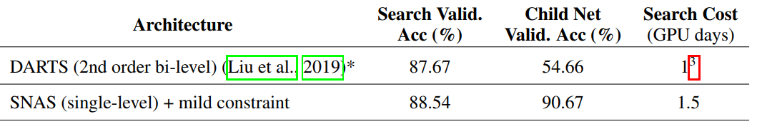
SNAS and DARTS
search
The supernet and subnet validation result are different without finetune in DARTS

Slide 15
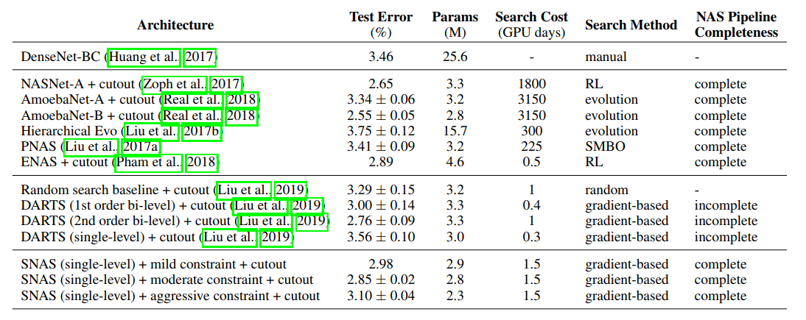
Result

Slide 16
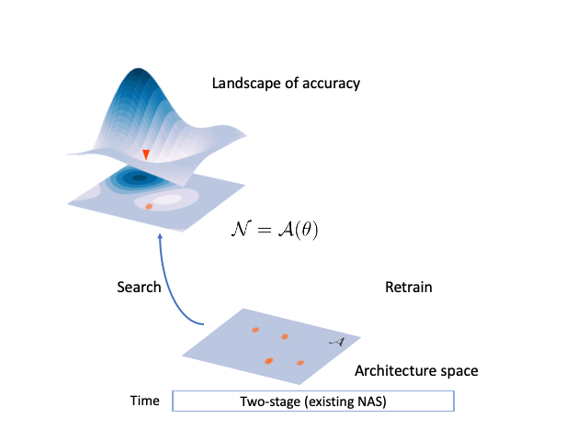
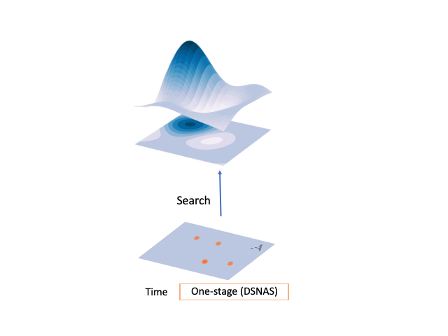
Retrain-two stage and one stage

Slide 17
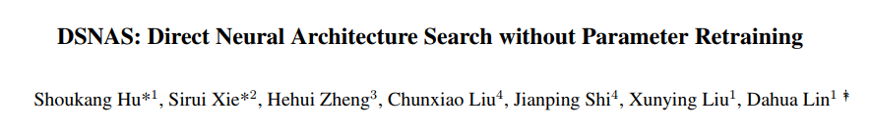
CVPR 2020

Slide 18
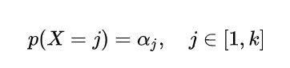
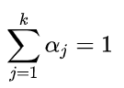
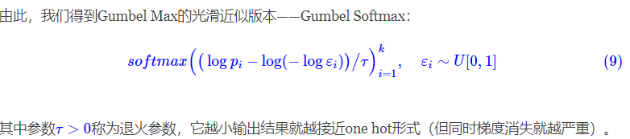
Categorical distribution

Slide 19
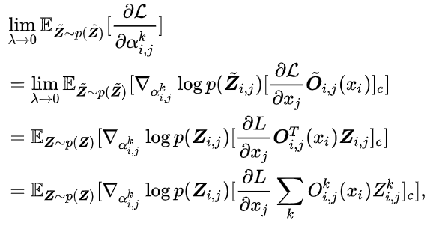
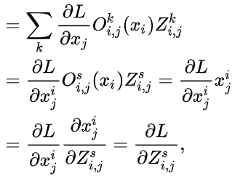
Gradient
Object function

Slide 20
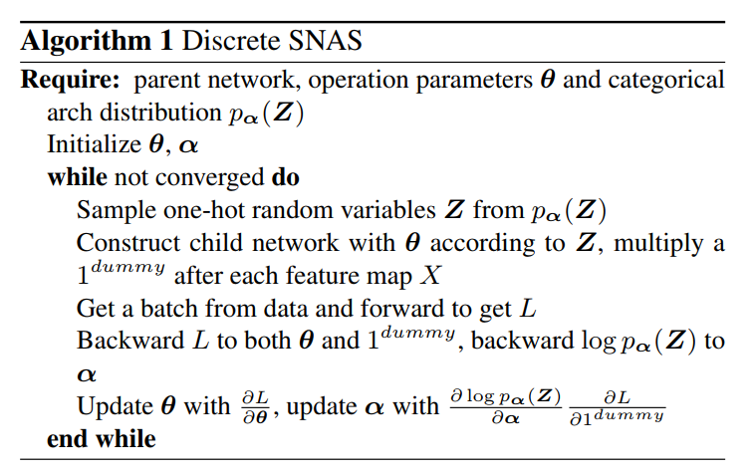
Algorithm

Slide 21
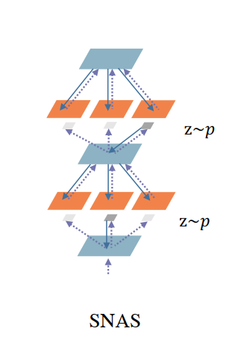
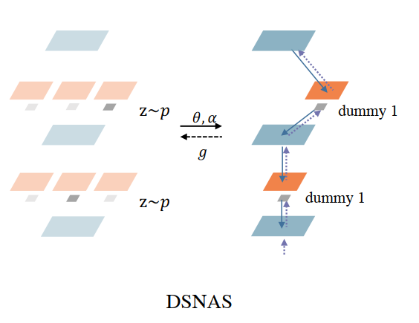
DARTS,SNAS and DSNAS
DARTS

Slide 22
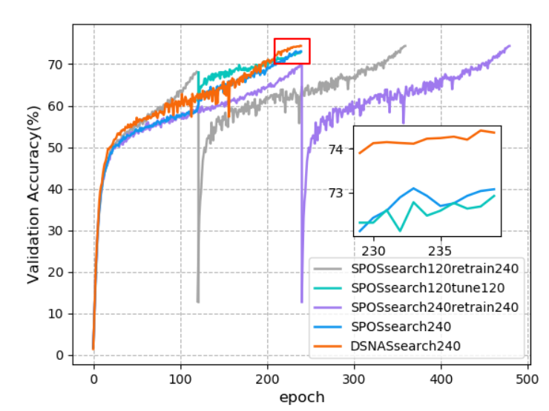
Result

Slide 23
Thanks

